Slide 1
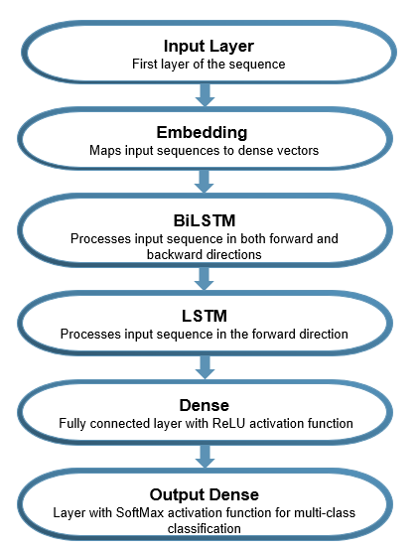
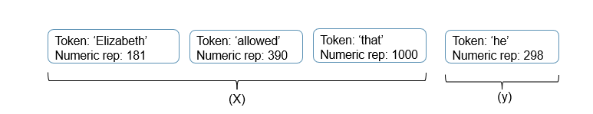
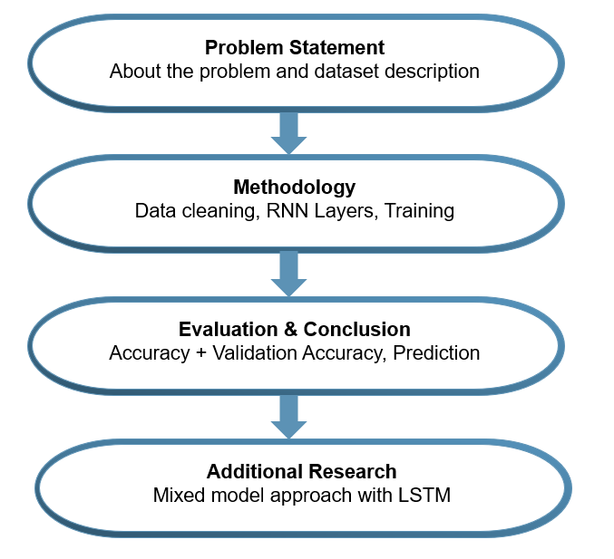
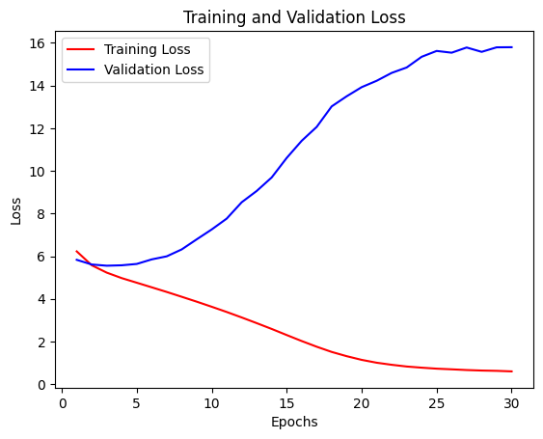
Next Word Prediction with Bidirectional LSTM
◆ Hema Srinivas Kodati ◆ Aruneema ◆ Kiranmayi Pendyala ◆ Apurupa Kakani
Under Prof. Lu Xiao
Abstract
Methodology
However, even with overfitting model, it was able to predict meaningful next words on input from the user. For e.g.
But this word - cynical
Mr. Collins could - be
Proceed form the - difficulty
Next-word prediction, a pivotal task in natural language processing (NLP), utilizes Bidirectional Long Short-Term Memory (LSTM) networks to forecast the most suitable word from a given set of antecedent words. Its applications extend to search bars, auto-correction, and email sentence completion. Achieving precision requires algorithms adept at grasping syntactic, semantic, discourse, and pragmatic nuances within word sequences. Deep learning algorithms, known for their proficiency in comprehending human language, present promising solutions.
Keywords: Bidirectional, LSTM, Deep Learning
Recurrent Neural Networks (RNNs), a class of deep learning models, are particularly effective in capturing word dependencies and contextual information for accurate next word prediction. Among RNN variants, Long Short-Term Memory (LSTM) networks excel in tasks that require sequential understanding and long-term dependency modeling, without losing on the information as the data processes through different layers of the model (vanishing gradient problem).
Additionally, Bidirectional LSTM (BiLSTM) further enhances the performance by capturing dependencies in both directions (past and future), extracting richer features, and handling ambiguity. This academic poster discusses the utilization of BiLSTM for next word prediction using trensorflow, highlighting their advantages in accuracy, contextual understanding, information retention, and sequence labeling tasks. The objective is to take in three words as user input to predict the fourth word. The outline of the study is as follows:
The research focuses on utilizing the ebook version of the renowned novel 'Pride and Prejudice' obtained from Project Gutenberg as the training text corpus. The dataset encompasses all chapters, including the Preface and concluding pages of the book. The corpus exhibits various inconsistencies, such as numerical values, unconventional characters (e.g., “ ", "-", ". ", ", ", ":"), whitespaces, symbols and numeric sequences.
Additional Research
The BiLSTM model showcased its proficiency in generating accurate predictions from user input. Reinforcing this observation, the paper titled 'A Comparative Analysis of ARIMA, GRU, LSTM, and BiLSTM on Financial Time Series Forecasting' conducted a comprehensive study on forecasting stock prices. The study revealed significant accuracy improvements—11.86% for BiLSTM and 20.32% for GRU in forecasting stock prices.
This success underscores the effectiveness of LSTM-based models in capturing systematic variations over time, driving further academic interest in different contexts. Scholars are integrating LSTM's memory cell and gated mechanisms with machine learning algorithms like ARIMA (Pirani et al, 2022), XGBoost (Dai et al, 2022), , and TCNN (Aslan, 2022) to enhance predictive capabilities for identifying trends and cyclic patterns in human activities.
For instance, in Human Activity Recognition, Mohamed et al. achieved a 95.602% accuracy with BiLSTM and word2vec embeddings to predict future sequence of activities while considering previous activities. While BiLSTM remains a robust choice, the Gated Recurrent Unit (GRU) emerges as an efficient alternative, since they use one less gate and less memory than LSTM models. For instance, application of a two layered GRU model on the same lines as our projects, brings out the accuracy of model at 81% (Aliyu Et al, 2022).
Data Cleaning
To remove unconventional characters, regular expressions were utilized to replace them with an empty string. The text was not treated for lower casing the letters to preserve the original meaning of proper nouns such as name of people or places.
Layers of the model
Fitting the Model
After the layers are created and stored in ‘model’, it is compiled with categorical cross-entropy loss function (quantifies how well the predicted probabilities align with the actual classes), the Adam optimizer, and accuracy as a metric.
To halt the training if the validation loss does not improve for a specified number of epochs, early stopping is implemented.
Additionally, model checkpointing is to save the best model weights based on the training loss. The model is trained on the provided training dataset (X_train and Y_train) for 30 epochs with a batch size of 64.
Introduction
Next the text corpus was tokenization using TensorFlow's Keras library. Then the tokens were further transformed into sequences of four consecutive integers using the tokenizer's 'texts_to_sequences' method. This step allowed to represent the text as numerical sequences for subsequent analysis.
E.g. Sentence: ‘Elizabeth allowed that he’
Evaluation and Conclusion
Subsequently, input features (X) and corresponding labels (y) were created. The input features, represented by 'X', were obtained by extracting the first three elements from each sequence, while the labels, represented by 'y', consisted of the fourth element of each sequence. To prepare the labels for training, one-hot encoding was implemented, converting the integer labels into a binary matrix representation. This encoding scheme facilitated the interpretation and comparison of the model's predictions during the training process.
After this the data is divided into train and test data with 80:20 split.
Layering
Six sequential layers are created for RNN model for next word prediction. They are as follows:
After running the model for 30 epochs, with a batch size of 65 the results were as follows:
The loss on training data was 0.69 while on validation data was 15.85
The accuracy on training data came out to be 82.57% while on validation data it was 10.11%
The models seems to be overfitting since validation loss is higher than training loss and the training accuracy is significantly higher than validation accuracy
References
Aslan, Serpil. (2022). A novel TCNN–Bi‐LSTM deep learning model for predicting sentiments of tweets about COVID‐19 vaccines. Concurrency and Computation: Practice and Experience. 34. 10.1002/cpe.7387. https://www.researchgate.net/publication/364548087_A_novel_TCNN-Bi-LSTM_deep_learning_model_for_predicting_sentiments_of_tweets_about_COVID-19_vaccines
Aliyu, E. O., & Kotzé, E. (2022). Stacked Language Models for an Optimized Next Word Generation. In IST-Africa 2022 Conference Proceedings (pp. 1-12). Miriam Cunningham and Paul Cunningham (Eds). IST-Africa Institute and IIMC. Retrieved from www.IST-Africa.org/Conference2022.
Dai, Y., Zhou, Q., Leng, M., Yang, X., & Wang, Y. (2022). Improving the Bi-LSTM model with XGBoost and attention mechanism: A combined approach for short-term power load prediction. Applied Soft Computing, 130, 109632. Retrieved from ScienceDirect website: www.elsevier.com/locate/asoc.
M. Pirani, P. Thakkar, P. Jivrani, M. H. Bohara and D. Garg, "A Comparative Analysis of ARIMA, GRU, LSTM and BiLSTM on Financial Time Series Forecasting," 2022 IEEE International Conference on Distributed Computing and Electrical Circuits and Electronics (ICDCECE), Ballari, India, 2022, pp. 1-6, doi: 10.1109/ICDCECE53908.2022.9793213. https://ieeexplore.ieee.org/document/9793213
M. Mohamed, A. El-Kilany and N. El-Tazi, "Future Activities Prediction Framework in Smart Homes Environment," in IEEE Access, vol. 10, pp. 85154-85169, 2022, doi: 10.1109/ACCESS.2022.3197618. https://ieeexplore.ieee.org/document/9852462
M. Soam and S. Thakur, "Next Word Prediction Using Deep Learning: A Comparative Study," 2022 12th International Conference on Cloud Computing, Data Science & Engineering (Confluence), Noida, India, 2022, pp. 653-658, doi: 10.1109/Confluence52989.2022.9734151. https://ieeexplore.ieee.org/document/9734151
Training vs Validation loss

Slide 2
Token: ‘Elizabeth’
Numeric rep: 181
Token: ‘allowed’
Numeric rep: 390
Token: ‘that’
Numeric rep: 1000
Token: ‘he’
Numeric rep: 298
(X)
(y)

Slide 3
Problem Statement
About the problem and dataset description
Methodology
Data cleaning, RNN Layers, Training
Evaluation & Conclusion
Accuracy + Validation Accuracy, Prediction
Additional Research
Mixed model approach with LSTM

Slide 4
Embedding
Maps input sequences to dense vectors
BiLSTM
Processes input sequence in both forward and backward directions
LSTM
Processes input sequence in the forward direction
Dense
Fully connected layer with ReLU activation function
Output Dense
Layer with SoftMax activation function for multi-class classification

